Slide 1

README.MD
LET’S START!

Slide 2




Yan Shi
Medium Human, Lawful Neutral
Class: Digital Media Data Specialist (10 months?!)
Subclass: Data Engineer
Proficiencies & Skills & Duties:
Python, SQL, AWS Redshift
ETL Processes, Pipeline Management/Maintenance, Web/PDF Scraping
Documentation, documentation, documentation
Fun Facts
🏠 Has lived in Hong Kong (born), Philadelphia, Indiana, and DC/MD (5+ years!)
😭 Allergic to most animals, lactose intolerant
📹 Graduated w/ a broadcast journalism & computer science double major (2018)
⚔️ DMs over the weekend

Slide 3





Work! Goals! Loops!
How I work, set goals, and enjoy feedback
Small groups over big groups
Take notes, ask questions
Setting reasonable expectations
Setting deadlines early / updating frequently
Feedback is ❤❤❤.
Though my work tends to be a one-person show. Loves collaboration, though, and rubber ducking
Will ask even the ones that may seem “obvious,” or ask you to repeat yourself. Will also take the time to research tools / methods for a project before diving in
For stakeholders and myself. Also, will respect your time & expect you to do the same
The earlier the better in case Something Terrible Happens™. Transparency is also golden
Preferably one-on-one. Writing preferred, but verbal is good, too. Values forwardness, but does not tolerate blatant rudeness

Slide 4
Communication Methods
How to reach me
If quick questions, troubleshooting code, lunch:
Then: Slack me! Or knock on my cube. Or tap my shoulder.
If longer questions, requests, explanations, I’m not here:
Then: Email me! Include as much information as you think is necessary – overexplain if you need to.
Note: I don't have Slack downloaded on my phone, but I do have my work emails connected.

Slide 5

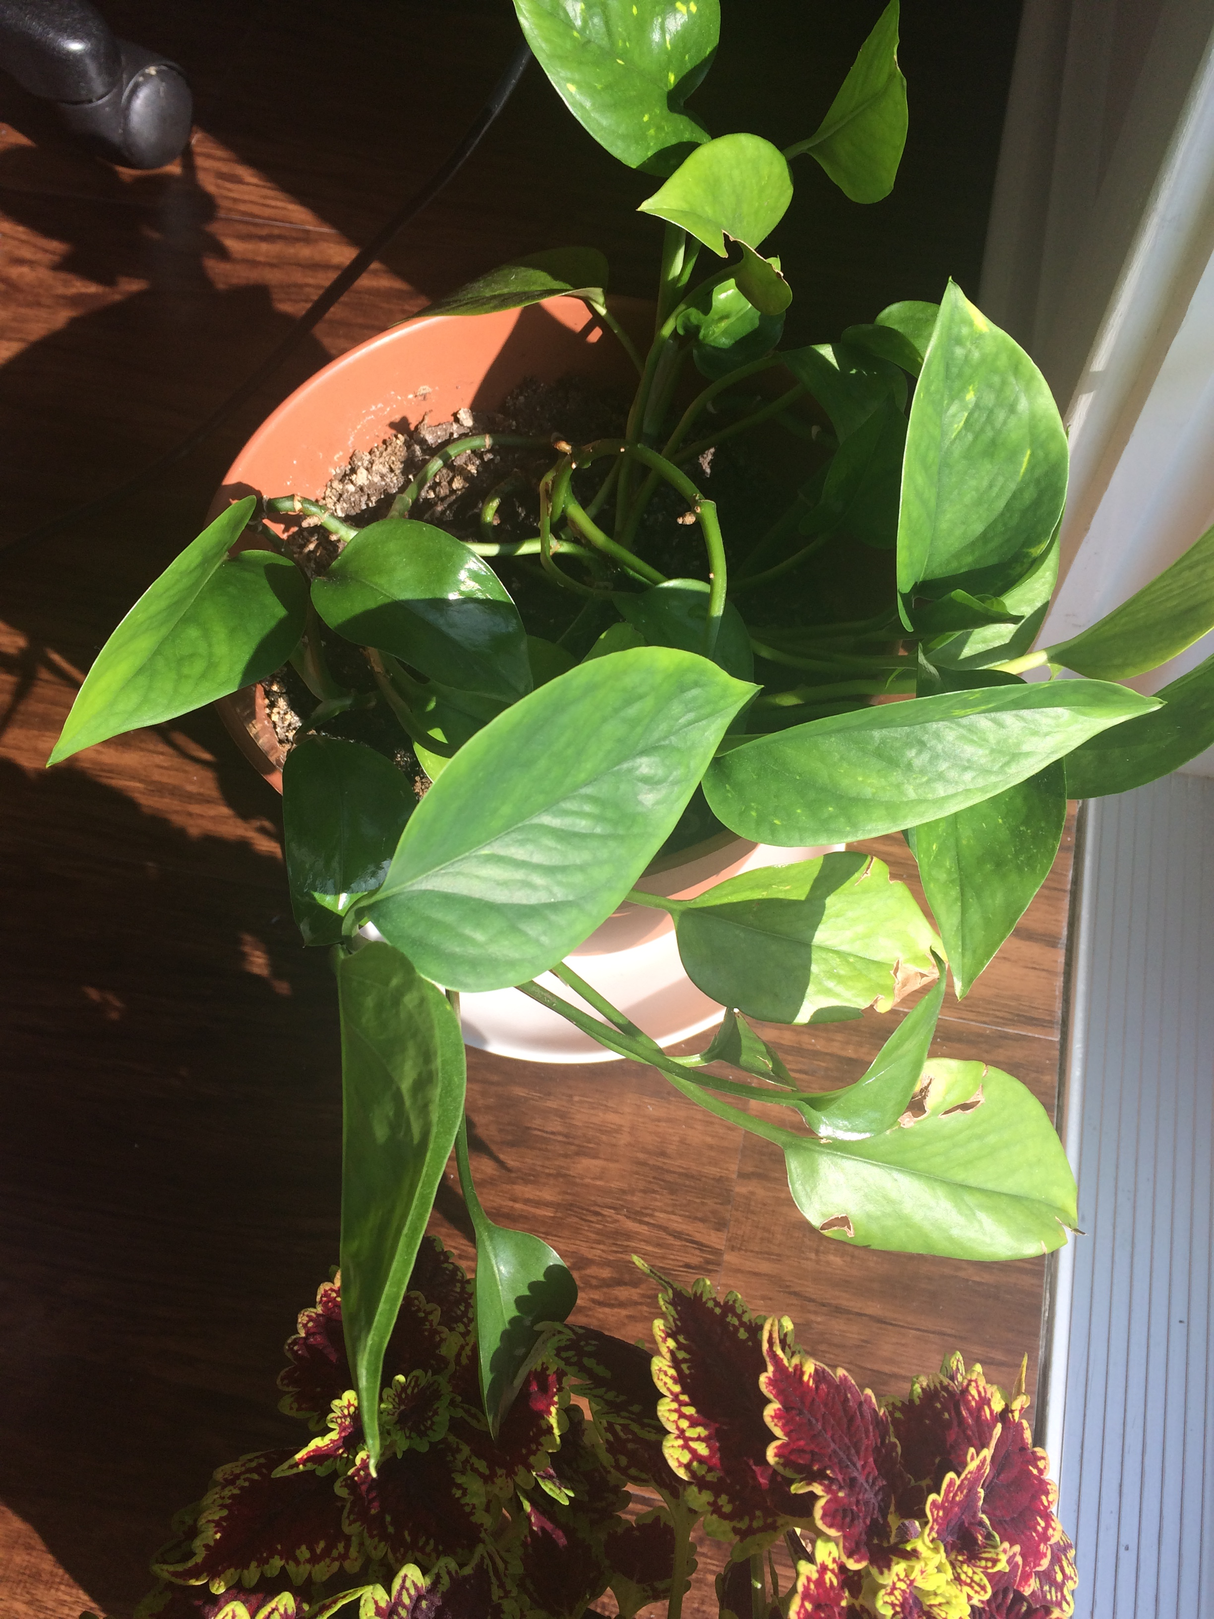
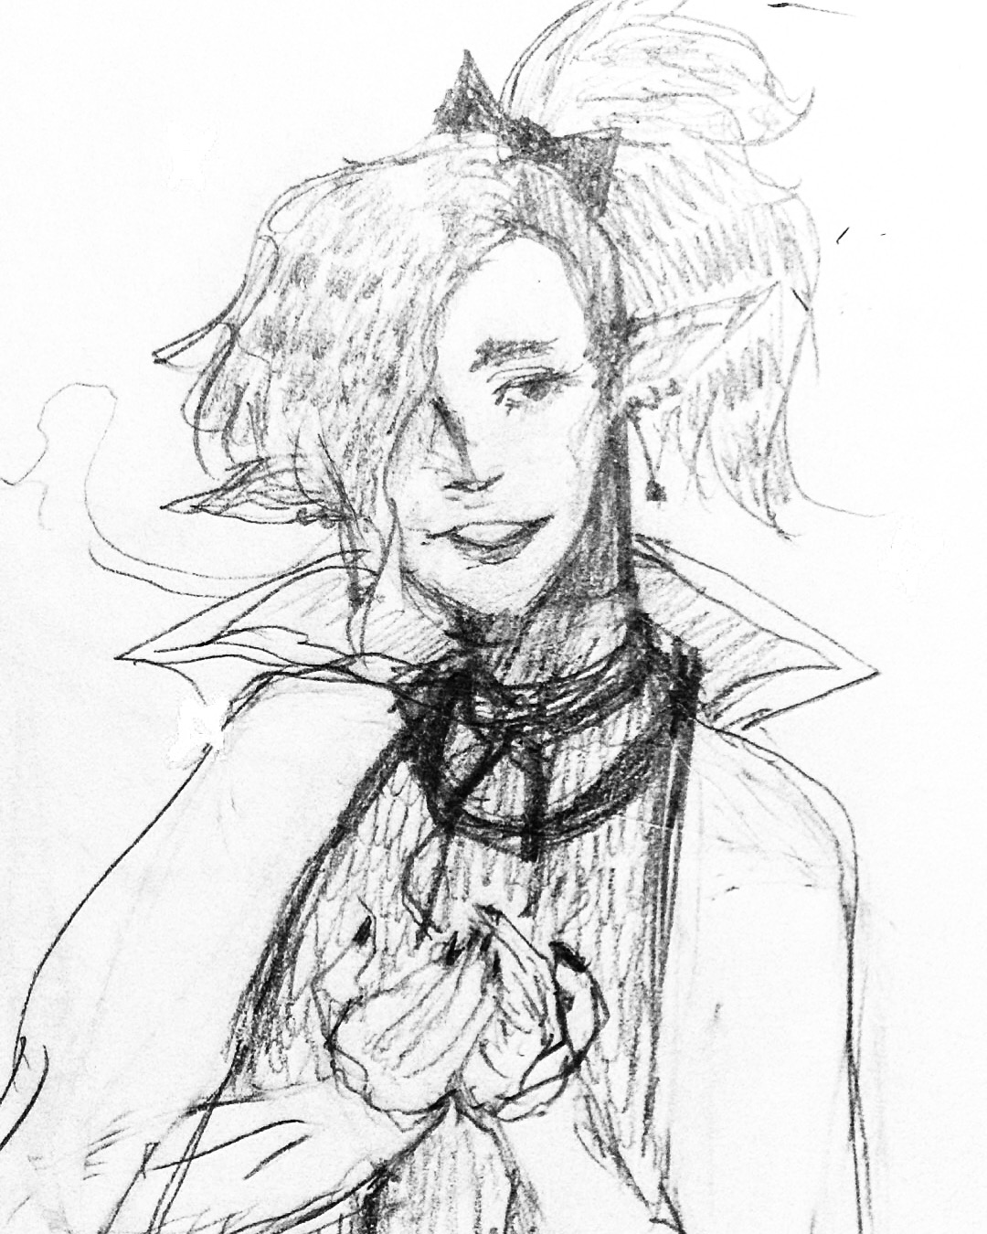
Other Things
Extra facts, things to note, and pictures
Mental health is important to me
Depression & anxiety, treated in the past
May come across as low-energy or quiet some days
Plant enthusiast
I’ve too many, send help
I draw/doodle a lot
Digital/traditional, my planner’s full of doodles
#GamerKid
A big fan of JRPGs, RPGs, simulators, visual novels, etc.
Web Version:
https://oneyanshi.github.io/oneyanshi-readme/

Slide 6

THANKS FOR LISTENING!

